Slide 1
IMPROVING THE CUSTOMERS SATISFACTION BASED ON SEASONAL REVIEW ANALYSIS
Sai, METIN, RIYA

Slide 2
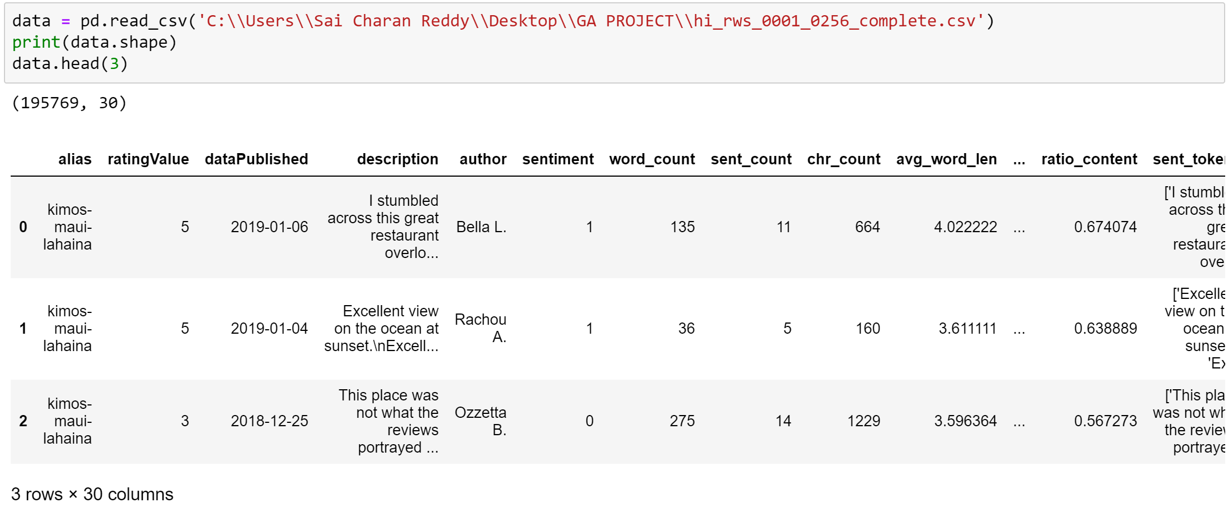
Data set:

Slide 3
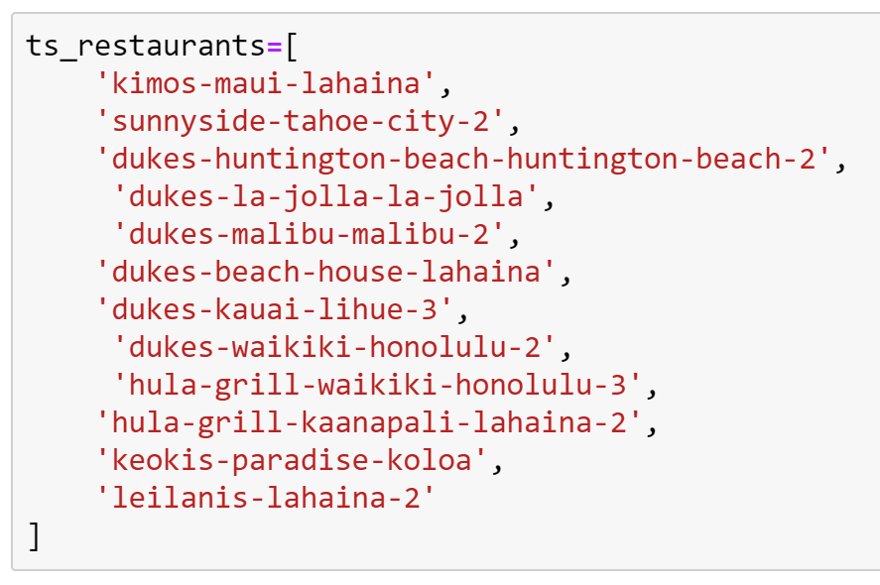
TS Restaurants

Slide 4
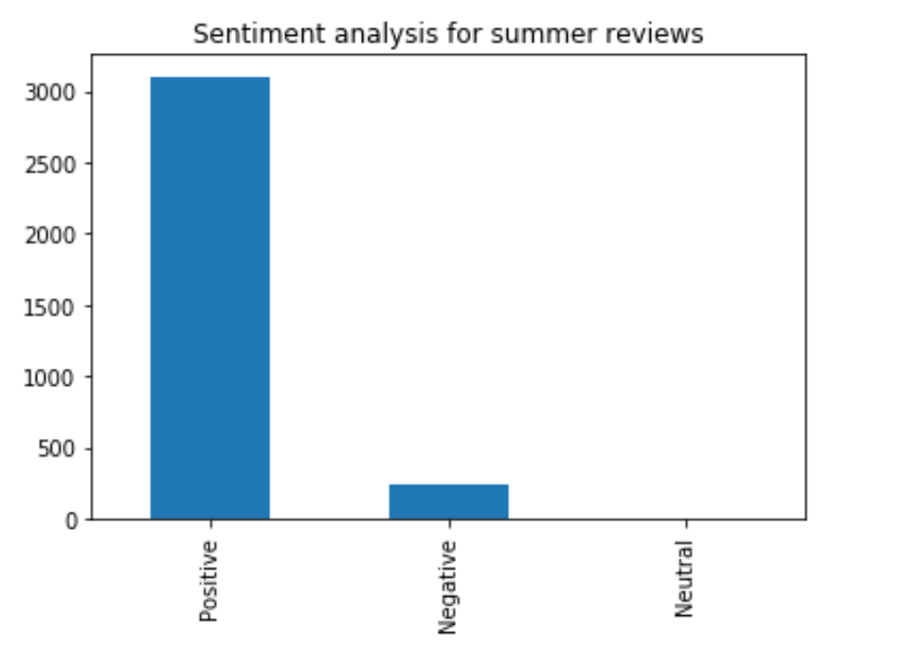
Number of Positive reviews: 3102, which is: 92.6
Number of Negative reviews: 242, which is: 7.2
Number of Neutral reviews: 5, which is: 0.1

Slide 5
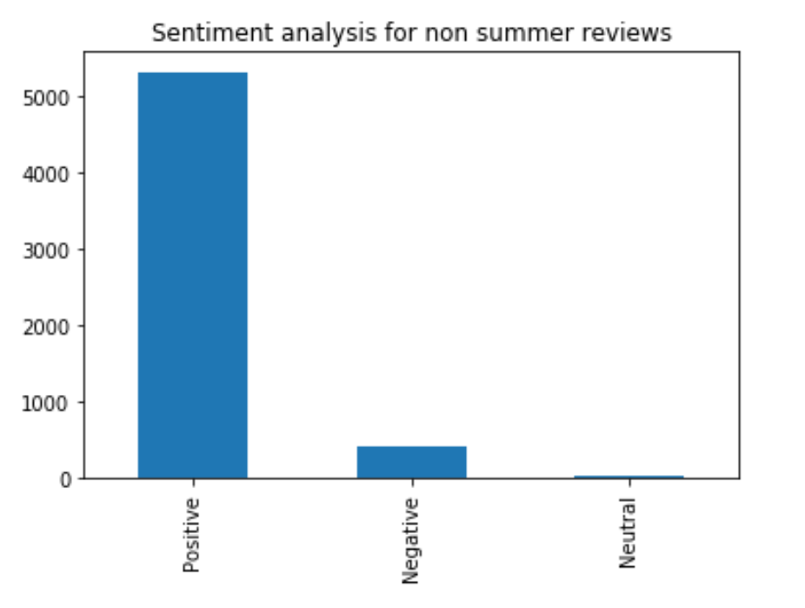
Number of Positive reviews: 5313, which is: 92.4
Number of Negative reviews: 413, which is: 7.1
Number of Neutral reviews: 22, which is: 0.3

Slide 6
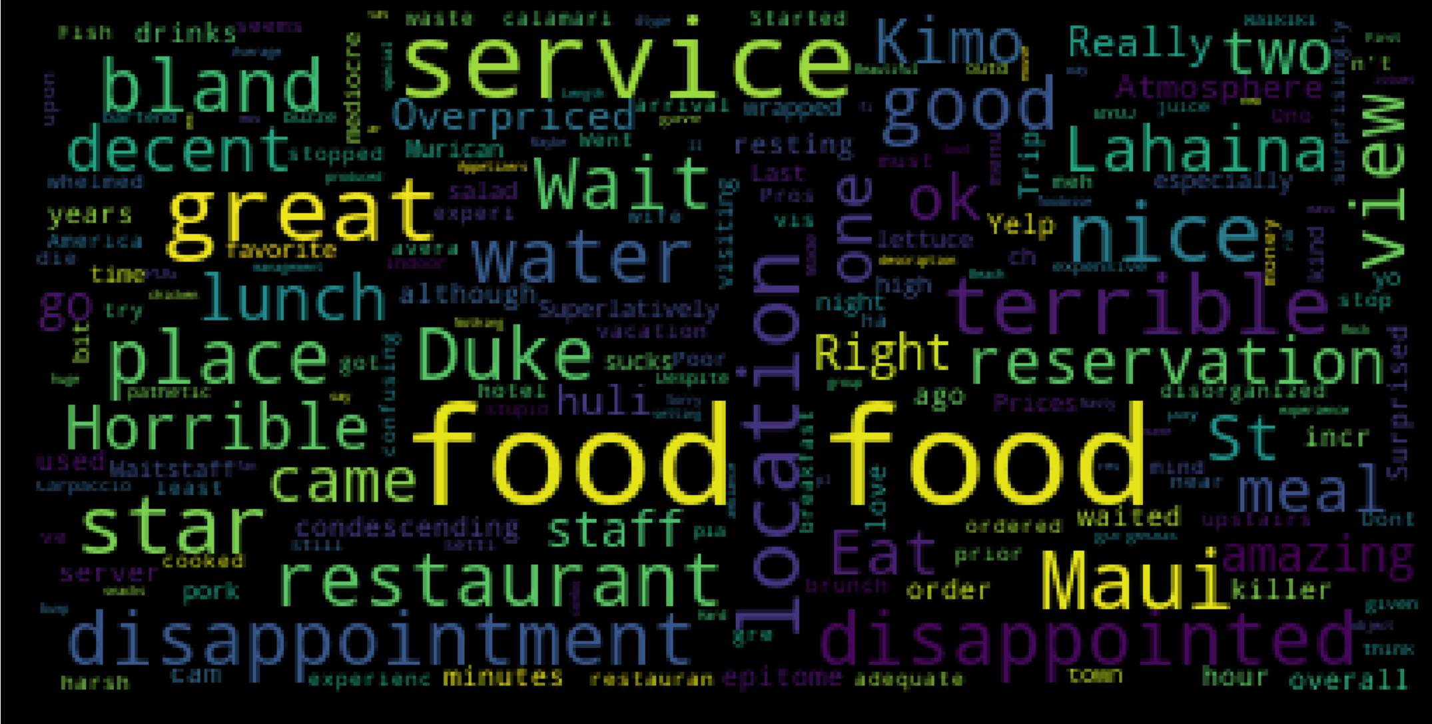
WordCloud on TS restaurants summer negatives
Terrible waiting
Service & Staff
Reservations
Dissapointment

Slide 7
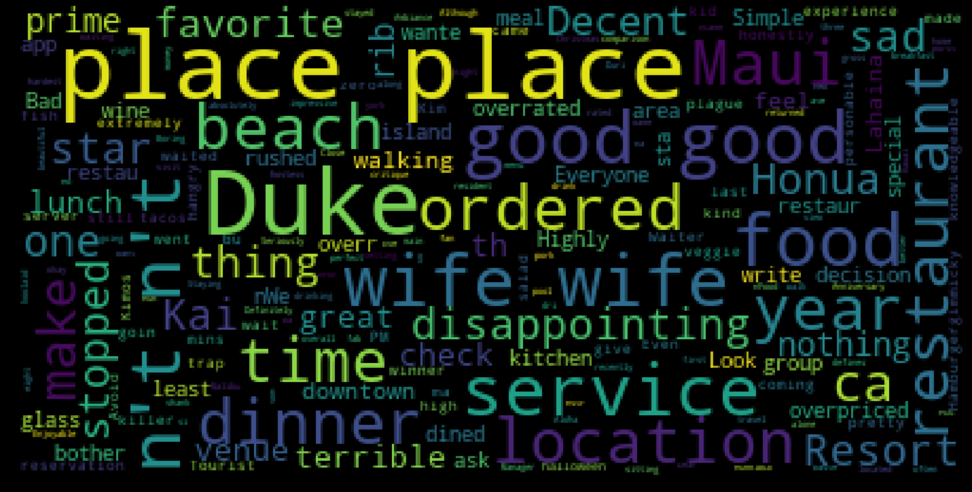
WordCloud on TS restaurants Non summer negatives
Dinner Location
Place
Beach
Location
Service

Slide 8
TOPIC MODELLING

Slide 9
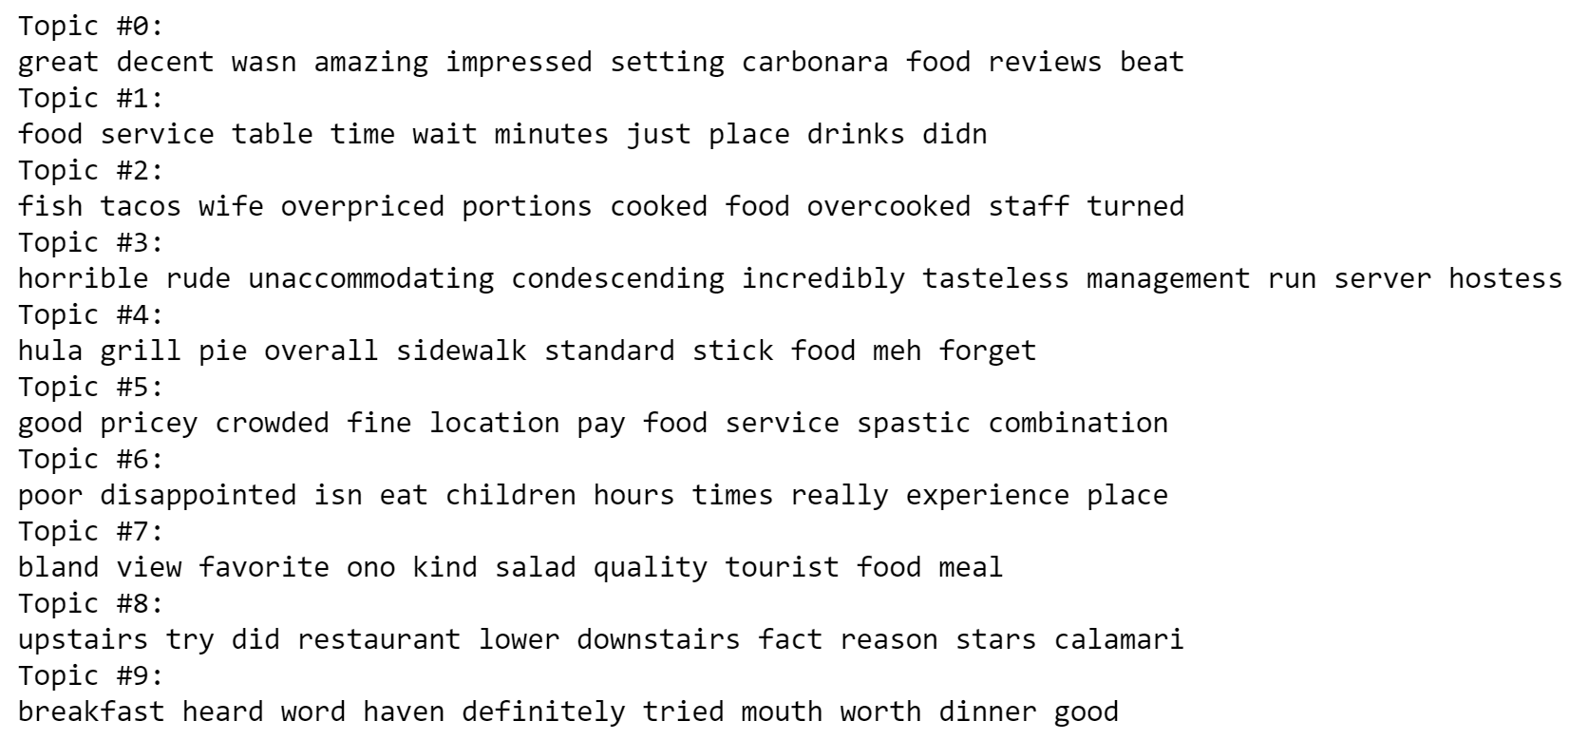
summer negatives

Slide 10
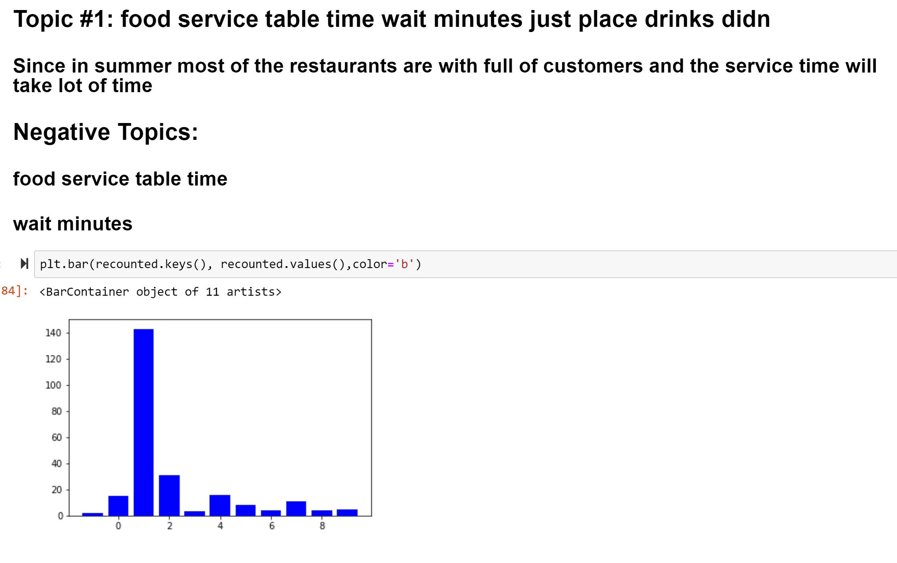

Slide 11
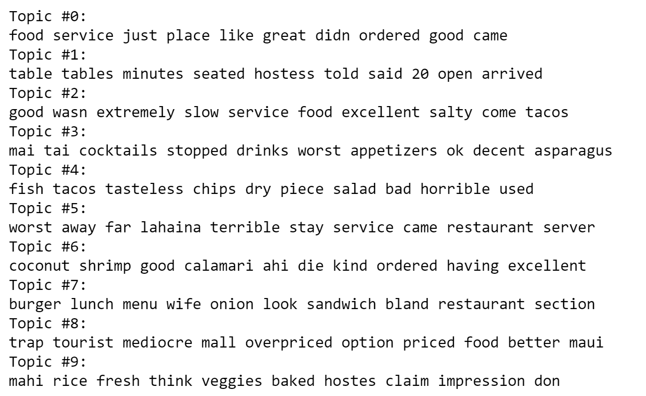
Topic Modelling on non summer negative

Slide 12
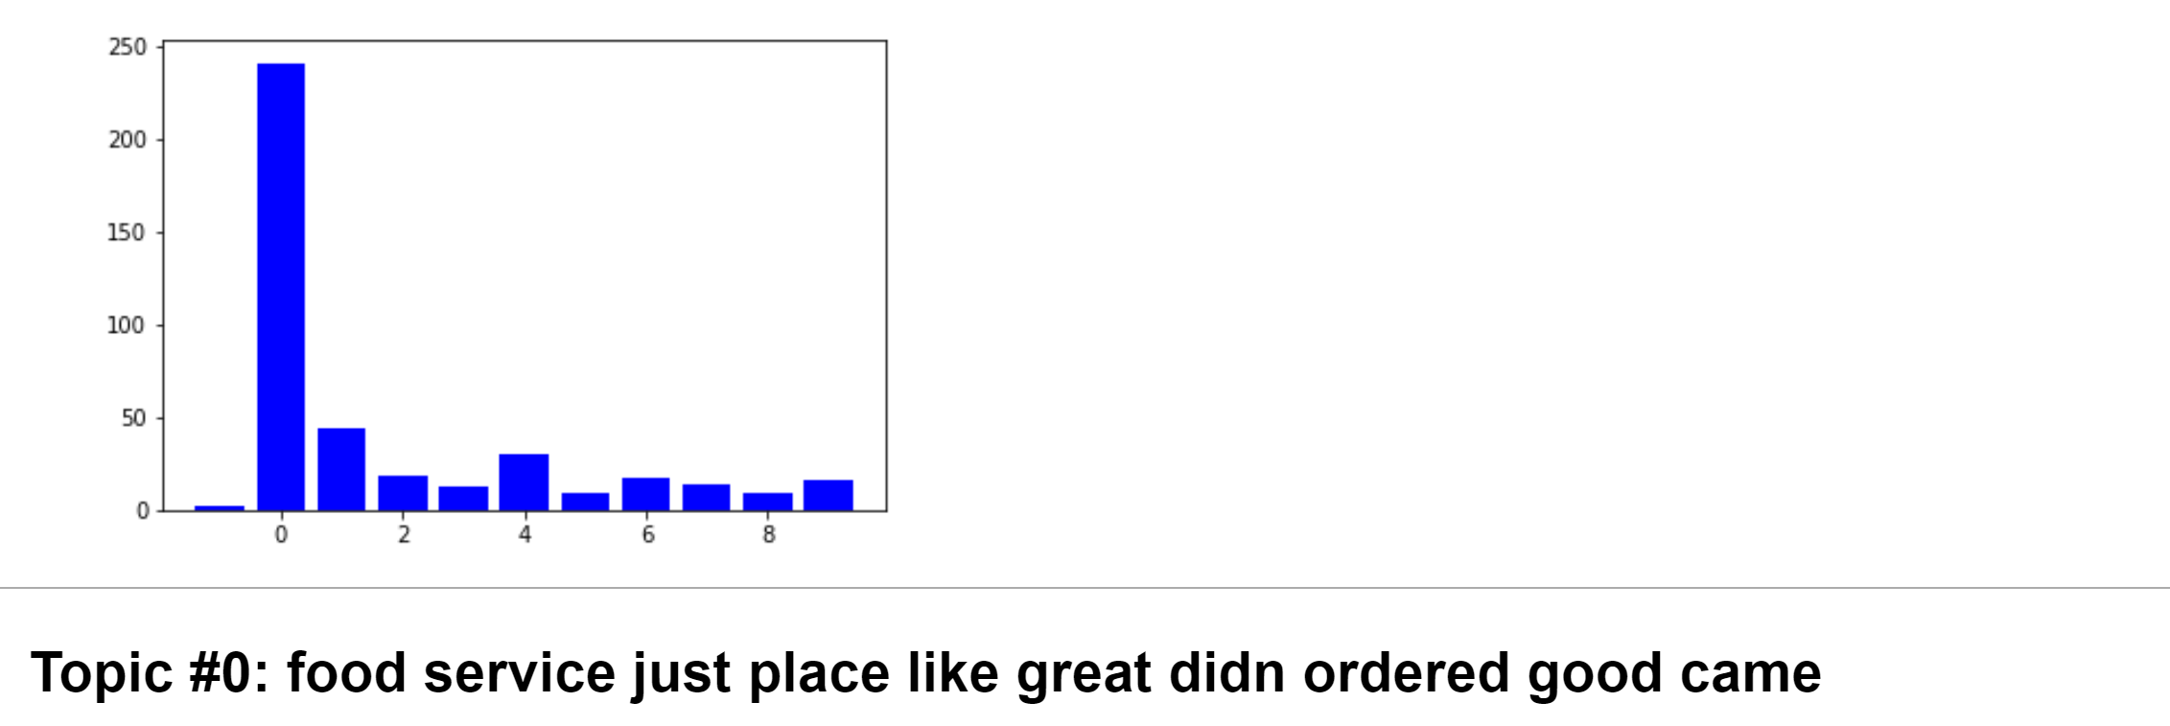

Slide 13
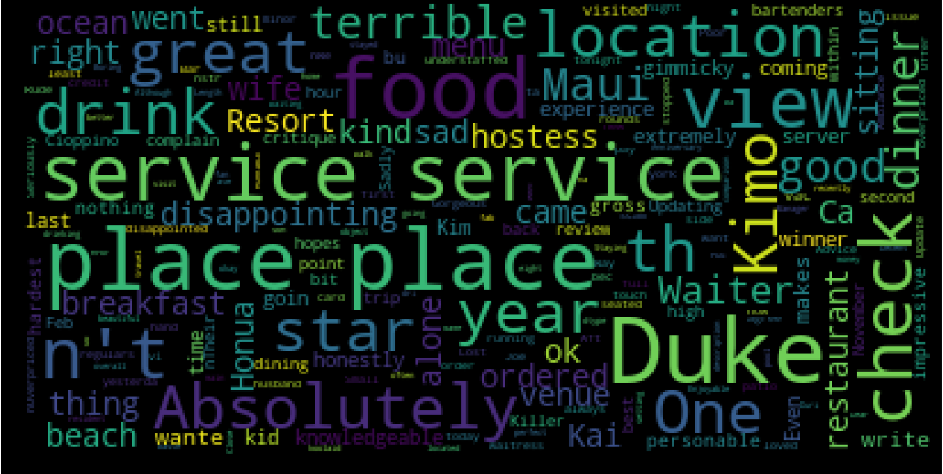
WORDCLOUD ON TOPIC – 0

Slide 14
N-GRAMS : TO FIND THE WORD COMBINATIONS

Slide 15
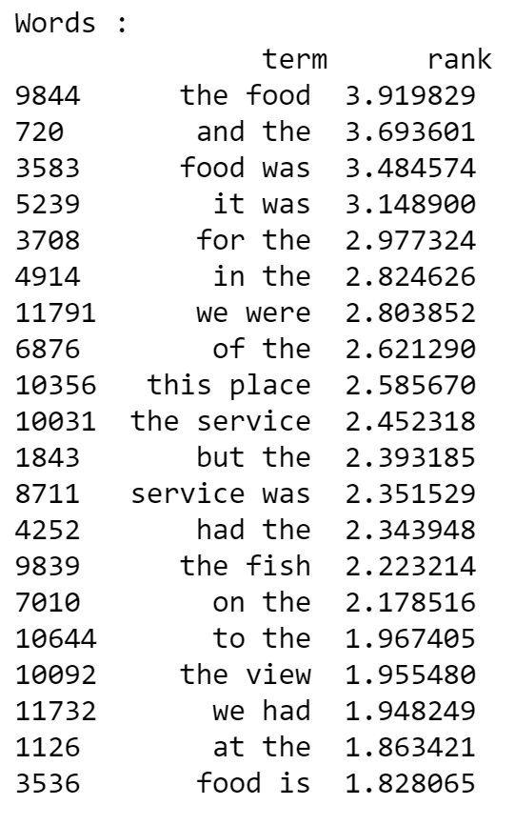
Summer negatives BI-GRAMS

Slide 16
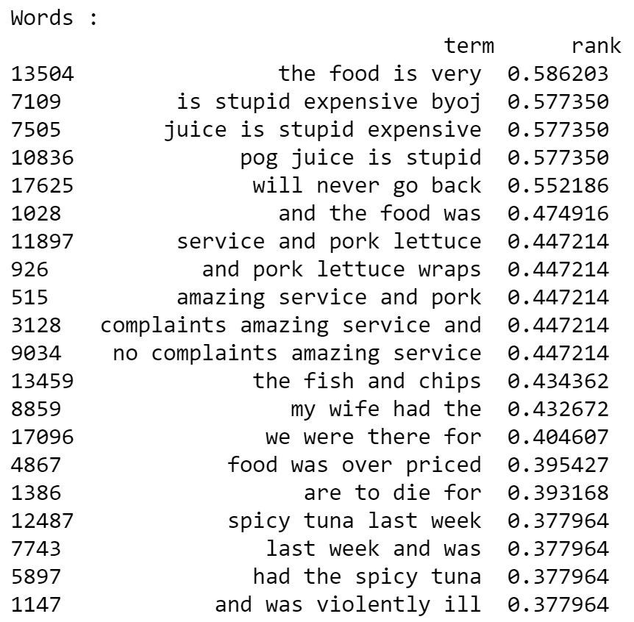
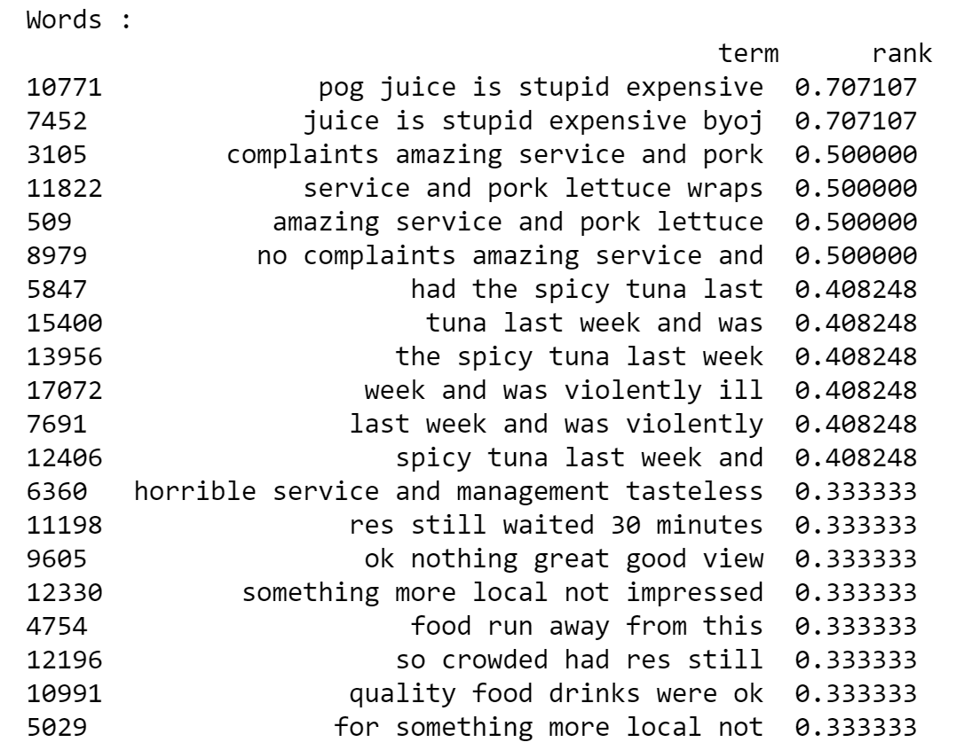
TETRA AND PENTA GRAMS

Slide 17
OBSERVATION: FROM SUMMER N GRAMS
Horrible Service
Horrible management
More waiting time
Expensive pog juice

Slide 18
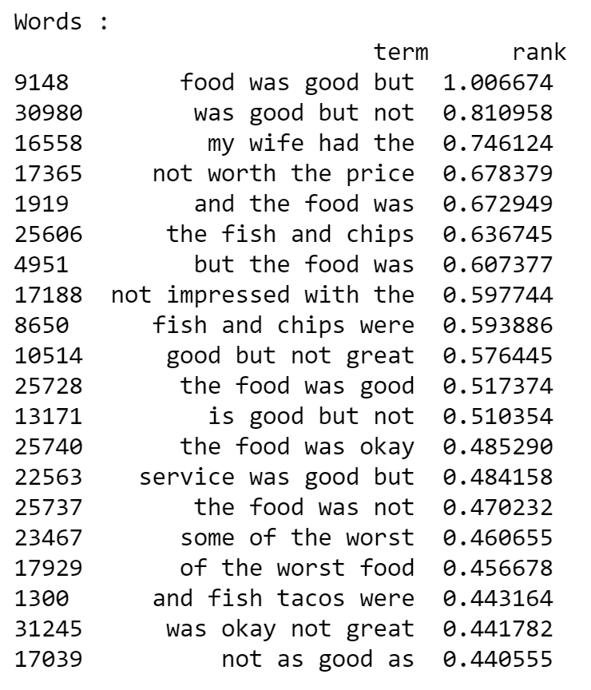
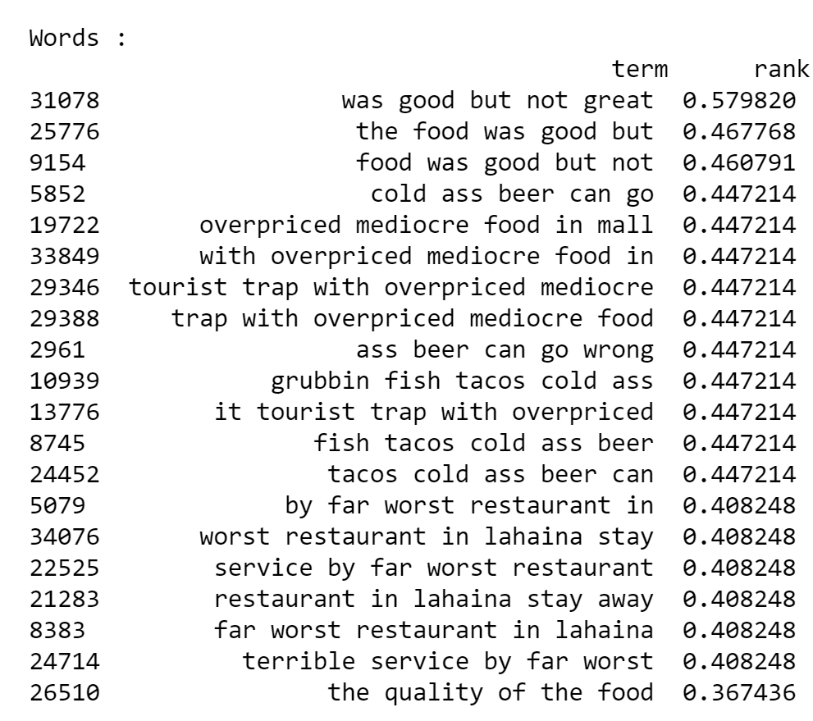
Non summer 4-grams & 5-grams

Slide 19
Overpriced mediocre food
Tourist trap with overpriced menu
Food was good but not great
Tacos are cold as beer
Lahaina restaurants food and service are bad

